Slide 1
Cross-Border Threat Analysis: Key Findings and Recommendations
An Analytical Review of Geospatial, Satellite, and OSINT Data
Date: 14/08/2024
Presenter: Somin Ramchiary
To: Senior Intelligence Officials

Slide 2
1.1 Objective
Analyzing cross-border activities between two neighboring countries, Country A and Country B.
The region in question is prone to geopolitical tensions, and there has been a recent increase in
reported movements across the border. Your role is to analyze the provided data, identify any
potential threats or significant patterns, and recommend actions to the senior intelligence team.

Slide 3
1.2 Data in hand:-
Geospatial Data: A dataset containing GPS coordinates, timestamps, locations, and movement types (entry/exit) for the past 6 months.
Satellite Details: A set of satellite details covering key areas along the border between Country A and Country B.
News Reports: A collection of recent news articles and social media posts related to cross-border incidents.
Historical Incidents Database: A summary of past border incidents, including dates, locations, and outcomes.

Slide 4
1.2 Task 1
Geospatial Analysis: Analyze the geospatial data to identify areas with significant cross-border movements. Use geospatial analysis tools to create heat maps and identify hotspots

Slide 5
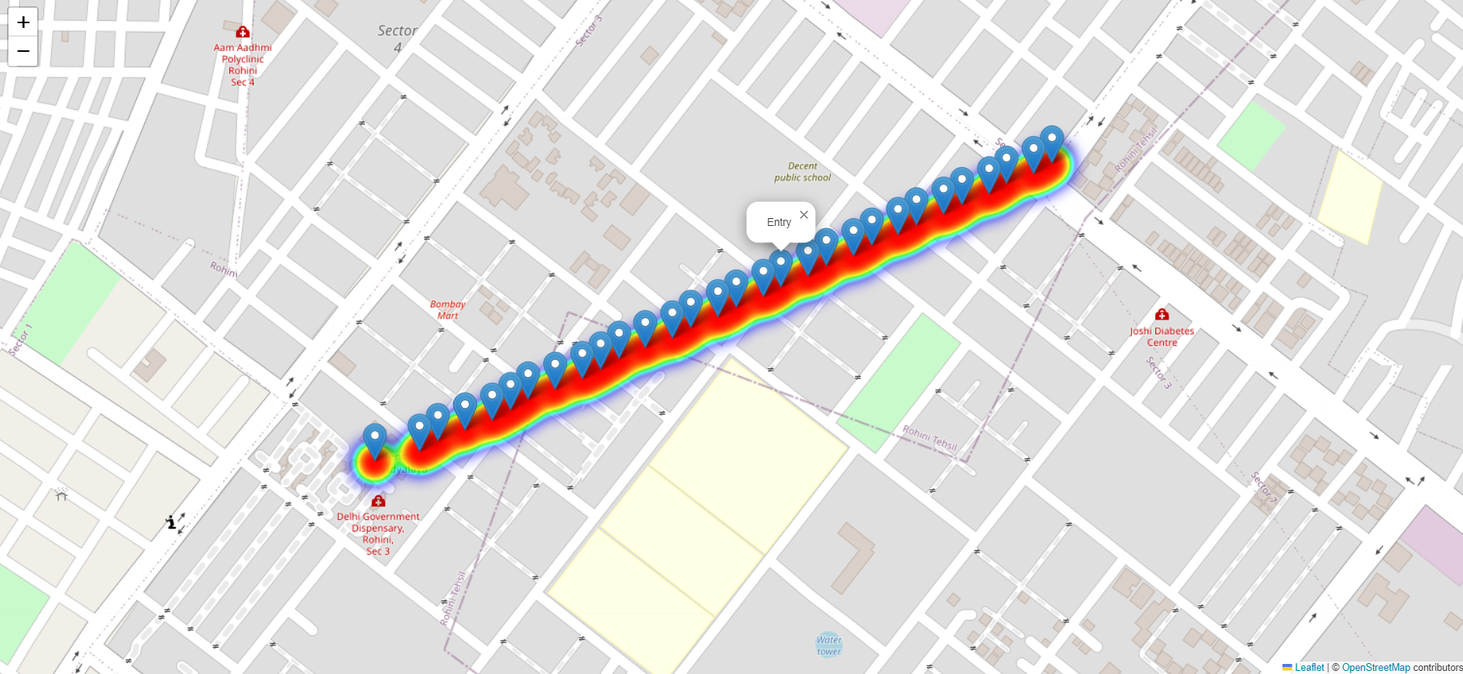
1.3 Geospatial Analysis
For interactive map Click here: Link

Slide 6
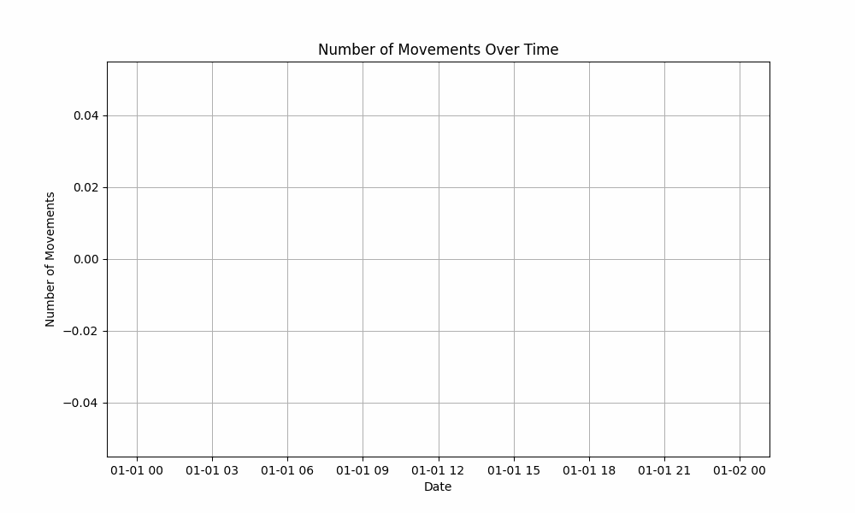
1.4 Movements

Slide 7
1.5 Summary
The visualization indicates entry and exits of Vehicles & Troops.
The co-ordinates are the hotspot for border reinforcement activities.
The heatmap indicates constant movements.
Over the course of time daily movement is recorded.
Interactive maps showed detailed movement paths and locations, allowing for easy identification of trends and significant activity zones.
The inclusion of terrain and infrastructure details provided context for the movements, helping to assess the impact on and relationship with local infrastructure.
Increased activity near sensitive or strategic locations could be indicative of heightened risk or potential security threats.
Unexpected patterns might reflect operational shifts or responses to external events.
1.6 Recommendation:-
Enhance monitoring, further investigation, and resource allocation for high-risk areas.
Get detailed view of the Co-Ordinates : Link and Additional Link

Slide 8
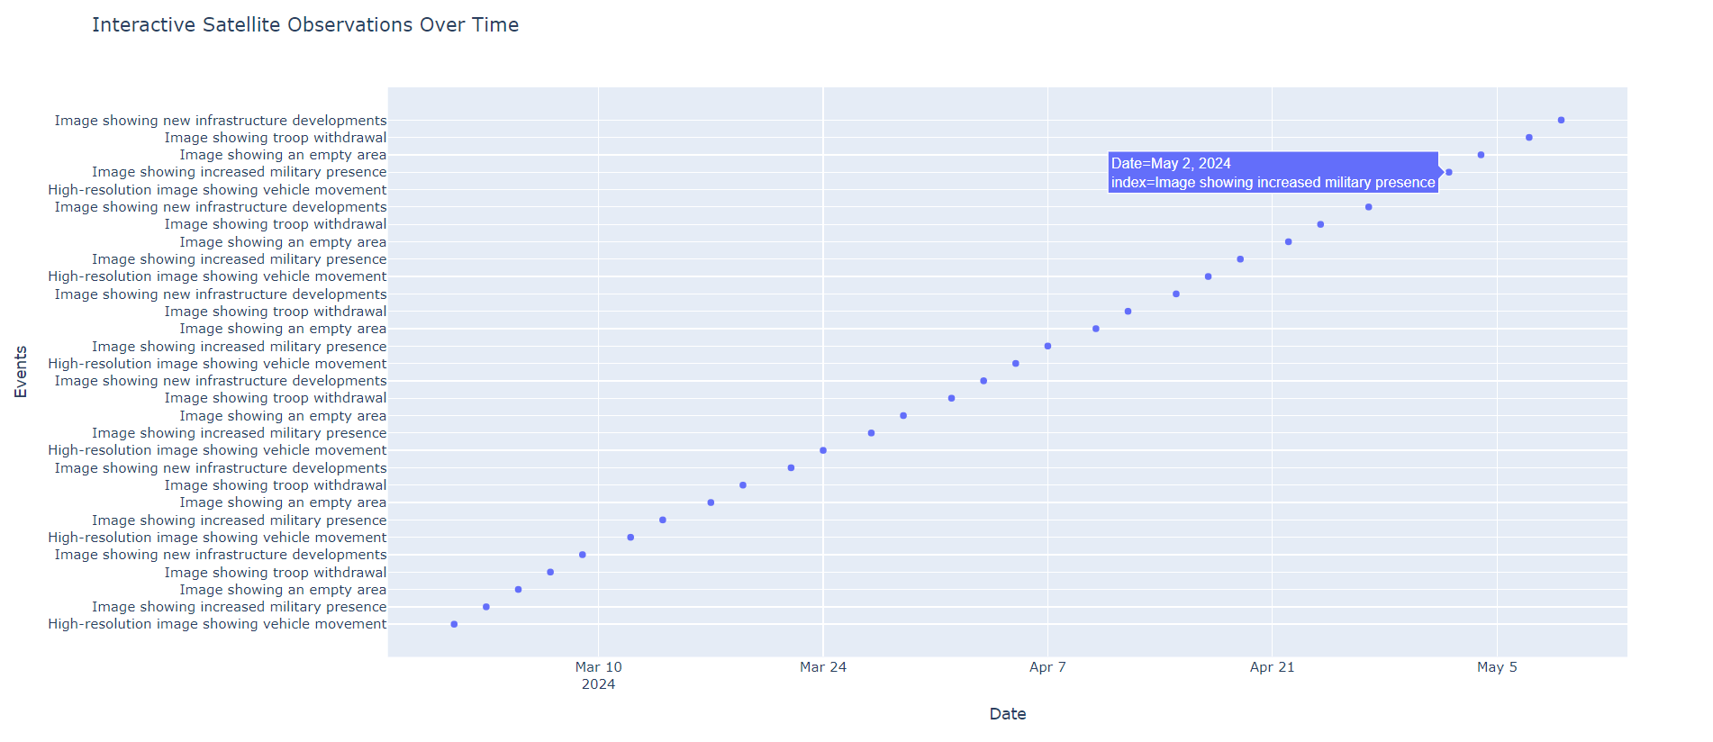
2.1 Satellite Details Interpretation (Graph Link)

Slide 9
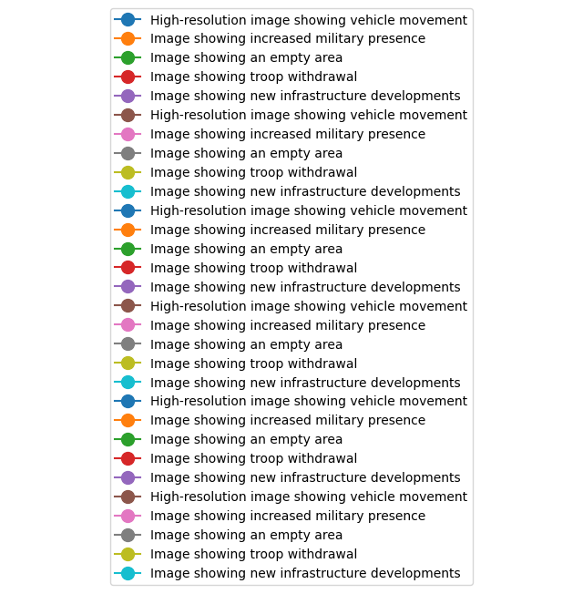
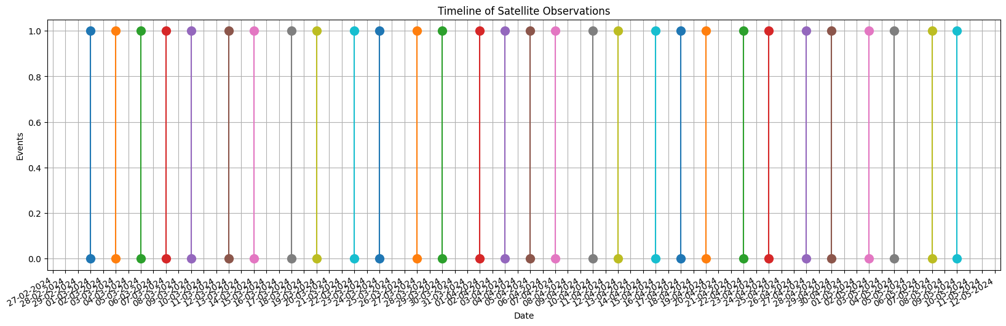
2.2 Graphical Visualization of Activities recorded over the time:

Slide 10
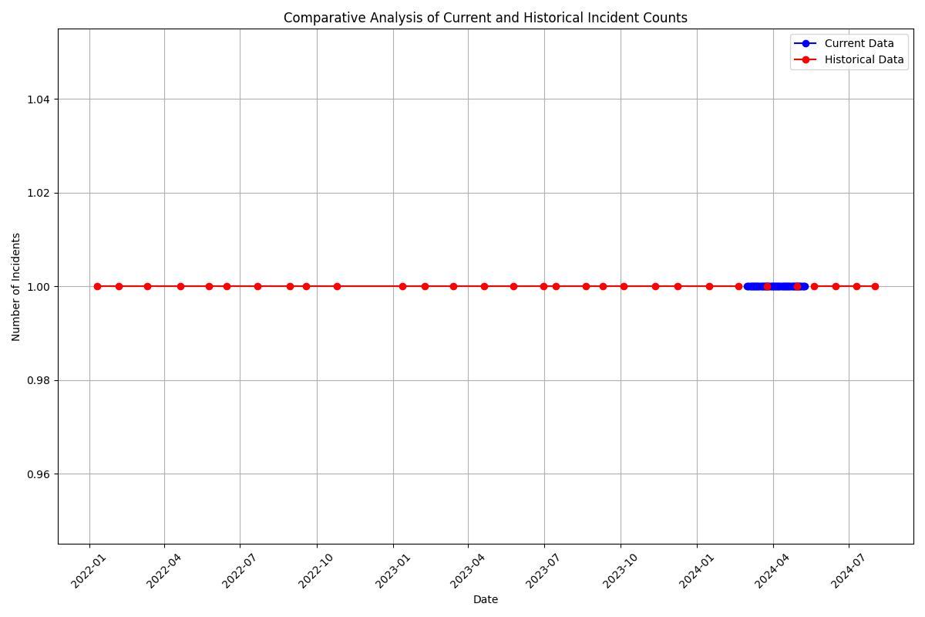
2.3 Comparison with historical Data

Slide 11
2.3 Summary
Detected new infrastructure developments, such as newly constructed roads, buildings, or fortifications near border areas.
The presence of new infrastructure could indicate strategic enhancements or preparations for increased activity in these regions.
Identified signs of troop deployments or increased military presence through changes in satellite imagery, such as clustering of vehicles or establishment of military camps.
Increased troop deployments near border areas could signify heightened tension or preparation for potential conflict.
Noted other significant changes such as alterations in terrain usage, new surveillance equipment installations, or changes in border patrolling patterns.
These changes may affect the security dynamics and require closer monitoring to assess their implications for cross-border stability.
2.4 Recommended Action:-
Continuously monitor areas with detected changes to assess their impact on border security and stability.
Investigate new infrastructure and troop deployments to understand their strategic purpose and potential impact on cross-border relations.
Coordinate with relevant agencies to address and respond to significant changes observed in satellite data.
2.5 Detailed Map : Link

Slide 12
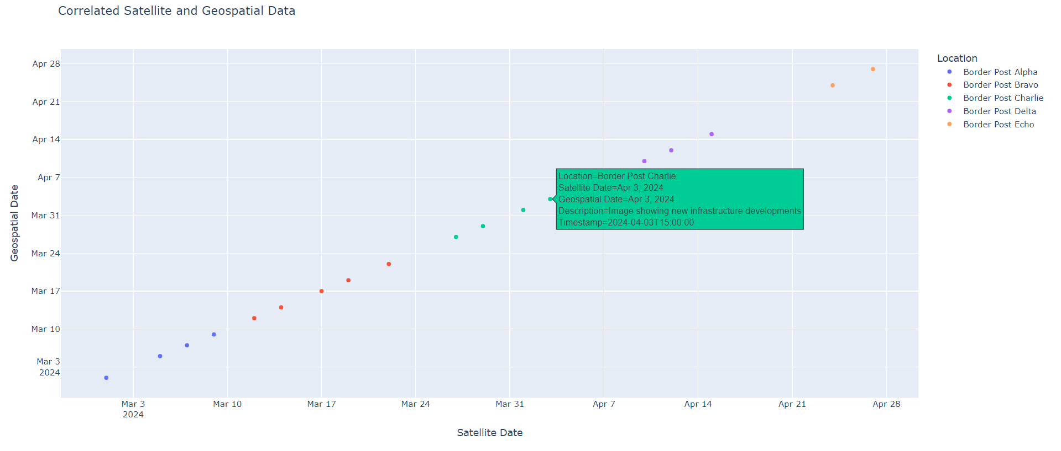
3.1 Correlation with Open-Source Intelligence (OSINT)
Interactive Graph: Link

Slide 13
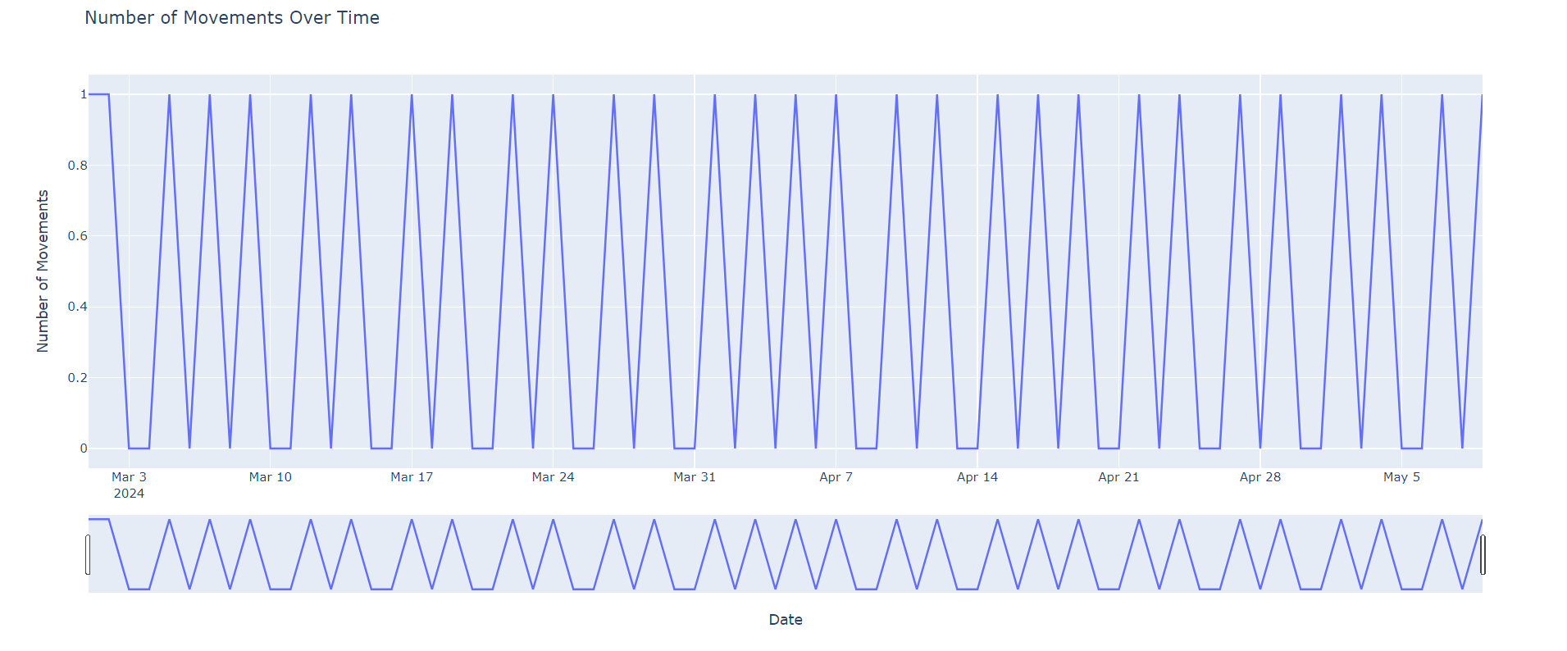
3.2 Activities over the time Series:
Interactive Graph: Link

Slide 14
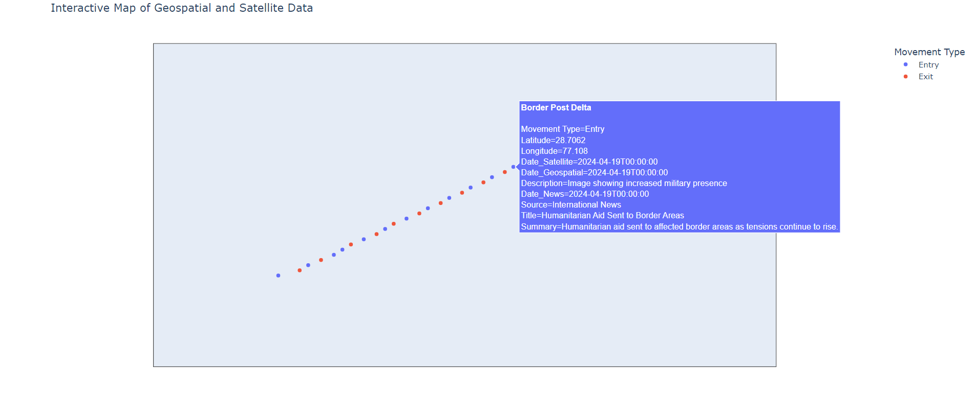
3.4 Correlation with News and Social Media
Interactive graph for better visualization: Link

Slide 15
3.3 Insights
Satellite imagery and geospatial data matched reports of increased military presence and infrastructure development in specific border regions.
Observations of new facilities and changes in border infrastructure from satellite images aligned with news articles detailing recent construction and upgrades.
Social media posts describing troop movements were consistent with satellite observations of increased military activity in identified areas.
Sentiment expressed in social media posts often reflected real-time developments observed through geospatial and satellite data.

Slide 16
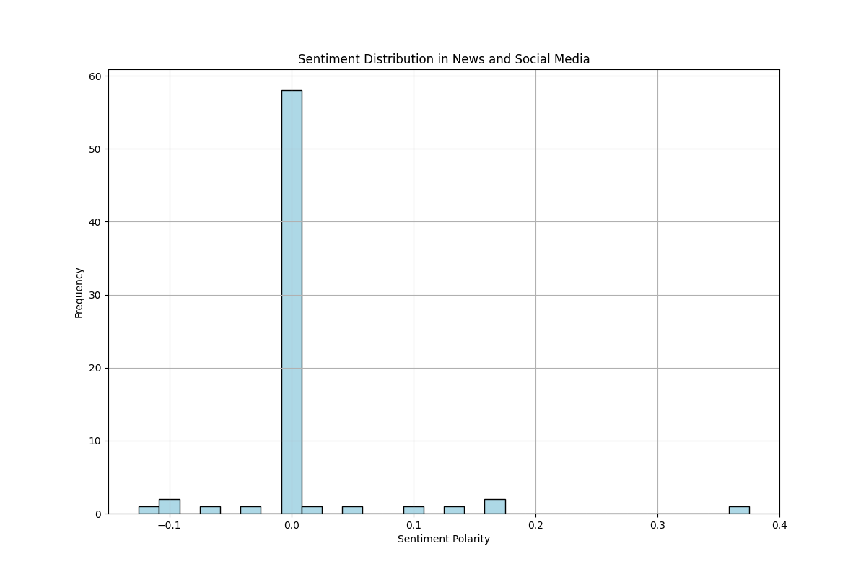
3.4 Sentiment Polarity on News & Social Media

Slide 17
3.5 Discrepancies (Graph Link)
Some news reports and social media posts included information that did not align with the observed data, such as unverified claims of troop buildups or border incidents not supported by satellite images.
Instances where reported incidents did not match the timing or location of observed events in satellite imagery.
Social media posts contained unverified or conflicting information that did not correspond with the geospatial and satellite data.
3.6 Impact on assessment
Corroborated evidence from OSINT supports the reliability of satellite and geospatial findings, providing a more accurate picture of the situation.
Consistent data across sources strengthens the confidence in observed trends and activities.
3.7 Summary
Alignment of satellite imagery with news reports and social media on military activity and infrastructure changes.
3.8 Recommendation
Continue verification, integrate corroborated findings into assessments, and monitor OSINT for ongoing updates.

Slide 18
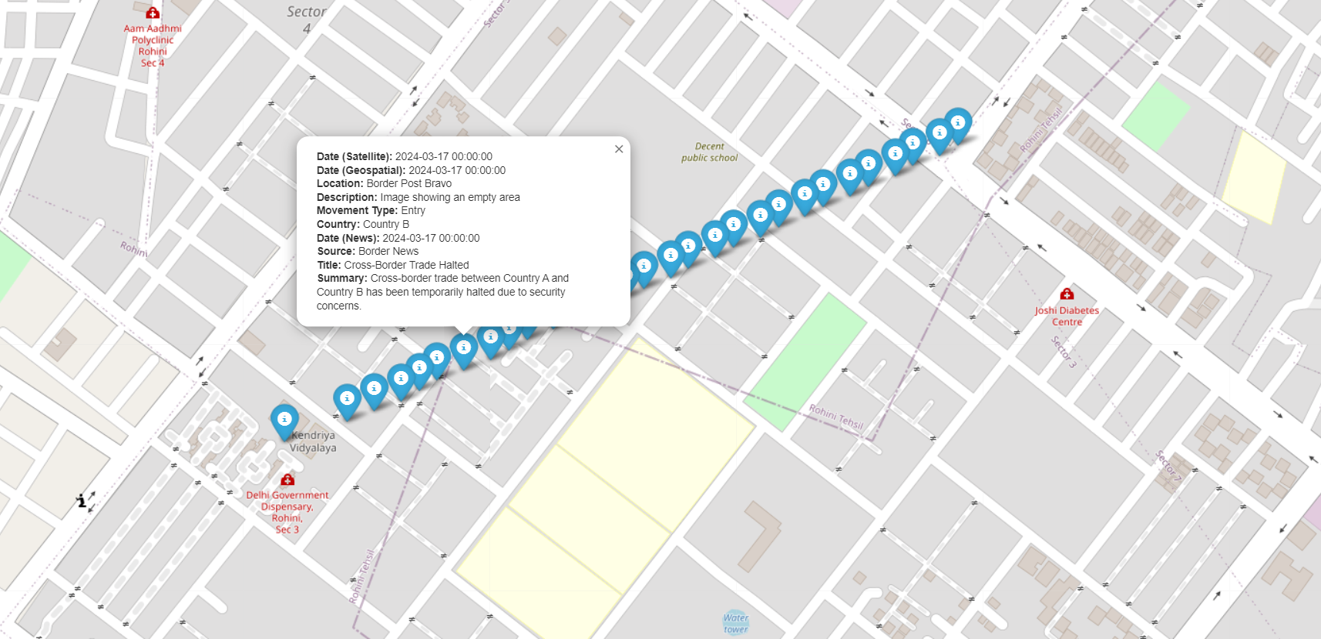
4.1 Threat Assessment and Recommendations
Interactive Map for better visualization: Link

Slide 19
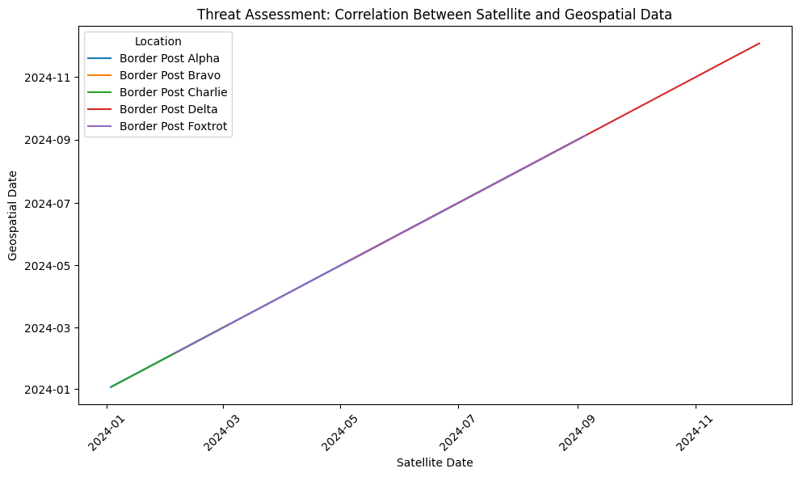
4.2 Thread Graph

Slide 20
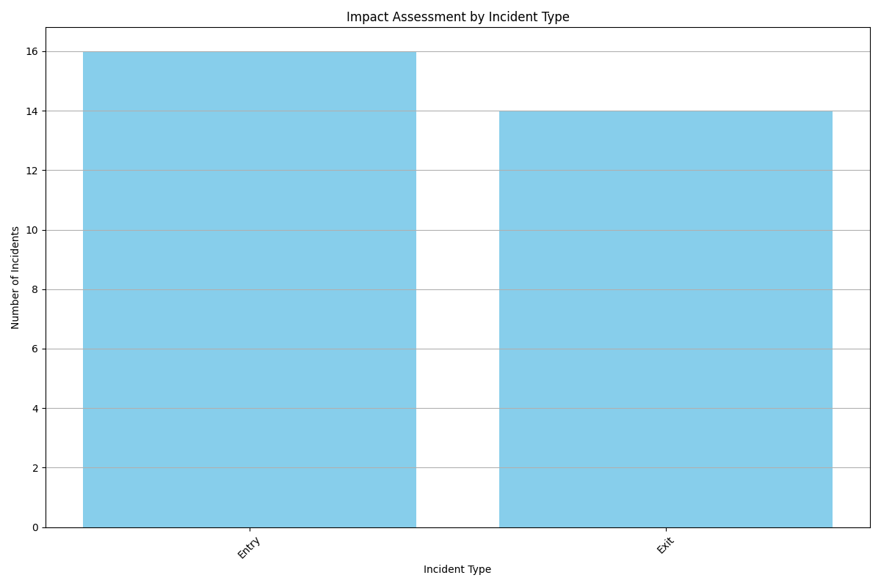
4.3 Impact Assessment

Slide 21
4.3 Potential Threads:
Recent satellite images reveal significant troop deployments and military infrastructure upgrades near the border. This could indicate preparation for potential conflicts or heightened border security.
Geospatial data shows atypical cross-border movements, including frequent and irregular troop movements and logistical operations. Such patterns may suggest escalated military activities or preparation for incursions.
New infrastructure, including border fortifications and surveillance systems, may signal efforts to bolster border control or prepare for increased confrontations.
Historical data reveals a pattern of increased tensions and incidents during similar periods of heightened activity. Past incidents of clashes and incursions align with current observations of increased military activity.
Recent patterns of movement and infrastructure changes are consistent with historical trends of border tensions and pre-conflict preparations.
4.4 Recommended Action:
Implement continuous monitoring of the identified hotspots using satellite imagery and geospatial data to detect any further changes or escalations in real-time.
Establish a system for receiving and analyzing real-time updates from satellite imagery and geospatial data to promptly identify any new developments or shifts in patterns.
Expand intelligence gathering efforts to include on-the-ground reports, local intelligence, and additional open-source information to complement geospatial and satellite data.
Enhance coordination with open-source intelligence sources, including news reports and social media, to corroborate findings and gain a broader perspective on the situation.
Conduct a thorough risk assessment based on current and historical data to develop contingency plans and strategic responses to potential threats.
Engage in diplomatic efforts to address rising tensions and prevent potential conflicts. Explore dialogue opportunities with neighboring countries to de-escalate the situation.

